Slide 1
Introduction to Ancient Greece

Slide 2
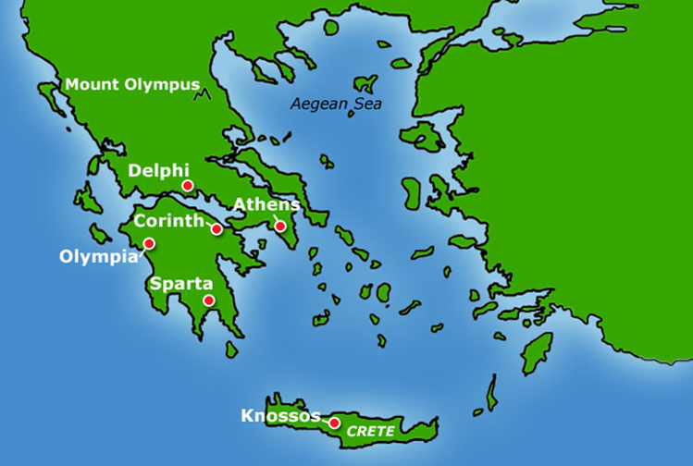
In ancient times, there was never one country called ‘Greece’
Instead, the area called ‘Greece’ now was divided up into small 'city-states’, like Athens, Sparta and Corinth
Each city-state ruled itself - they had their own governments, laws and army
All Greeks shared the same gods (who lived on Mount Olympus) and worshipped together at
sanctuaries like Olympia and Delphi
The ancient Greek world extended far beyond
mainland Greece
Many city-states established colonies in coastal
areas around the Mediterranean Sea and the
Black Sea

Slide 3
The Ancient Greek World
The Greek philosopher Plato said, "Like frogs around a pond, we have settled down upon the shores of this sea."

Slide 4
Your turn…

